Slide 1
Chapter 3
Image Enhancement in the Frequency Domain

Slide 2
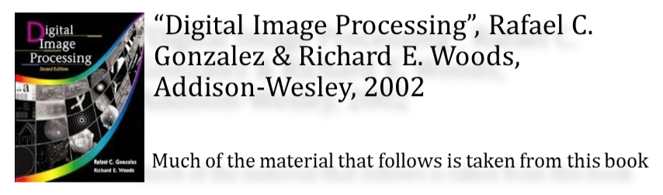
Chapter 3
REFERENCES
Slides by Brian Mac Namee
Brian.MacNamee@comp.dit.ie

Slide 3
Background
The French mathematician Jean Baptiste Joseph Fourier
  Born in 1768
  Published Fourier series in 1822
  Fourier’s ideas were met with skepticism
Fourier series
  Any periodical function can be expressed as the sum of sines and/or cosines of different frequencies, each multiplied by a different coefficient

Slide 4
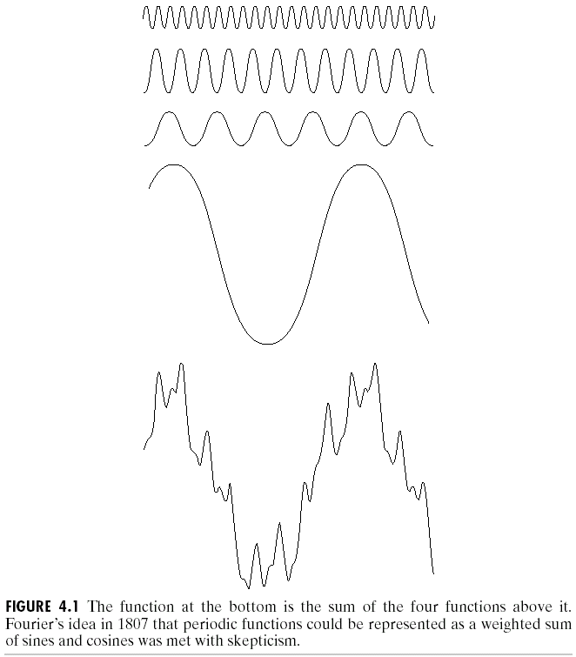
Frequency Domain

Slide 5
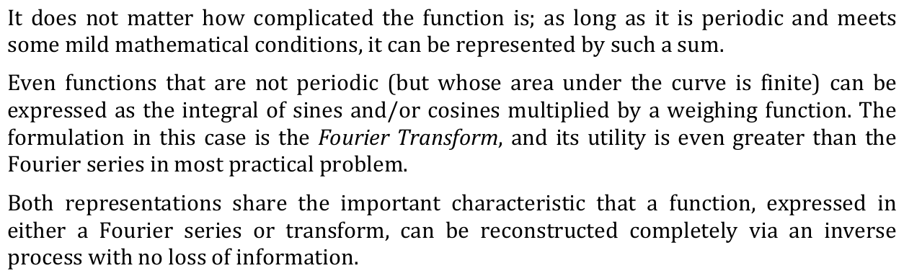
Frequency Domain

Slide 6
Fourier Transform
Fourier transform
  Functions can be expressed as the integral of sines and/or cosines multiplied by a weighting function
  Functions expressed in either a Fourier series or transform can be reconstructed completely via an inverse process with no loss of information

Slide 7
Application
Fourier Transform
Easier to remove undesirable frequencies
Faster perform certain operations in frequency domain than in spatial domain

Slide 8
Fourier Transform
Spatial, or image variables: x, y
Transform, or frequency variables: u, v

Slide 9
Introduction to the Fourier Transform and the Frequency Domain
The one-dimensional Fourier transform and its inverse
  Fourier transform
  Inverse Fourier transform

Slide 10
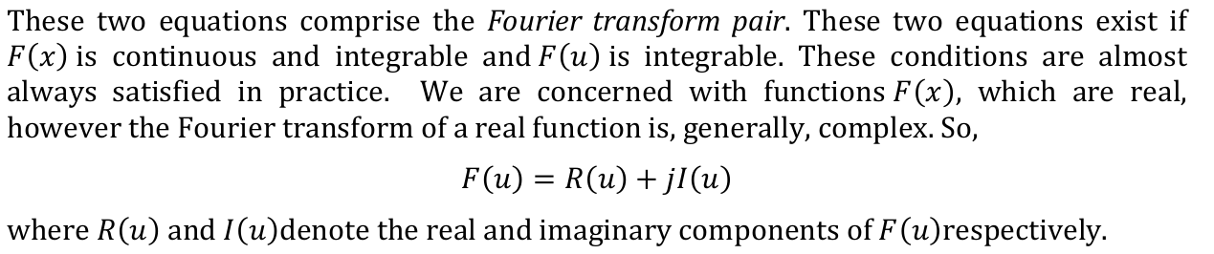
Introduction to the Fourier Transform and the Frequency Domain

Slide 11
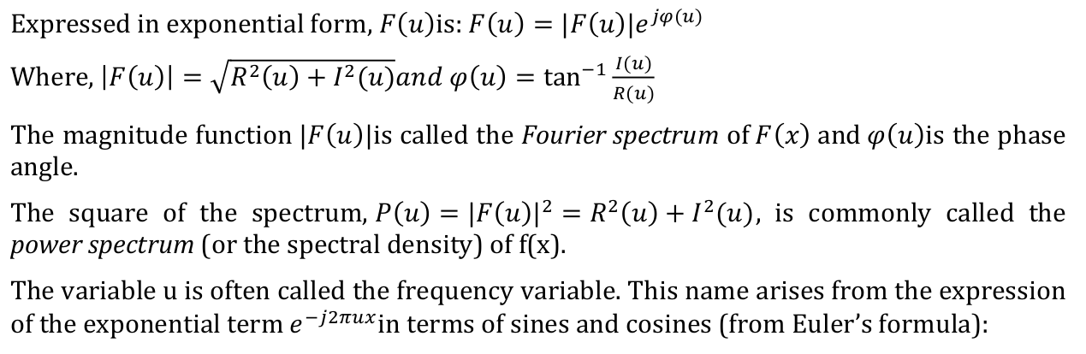

Introduction to the Fourier Transform and the Frequency Domain

Slide 12
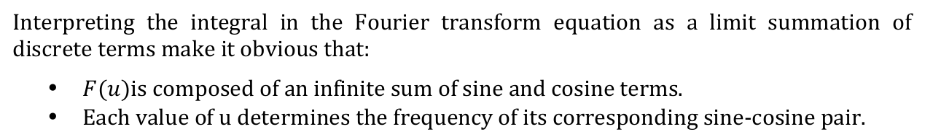
Introduction to the Fourier Transform and the Frequency Domain

Slide 13
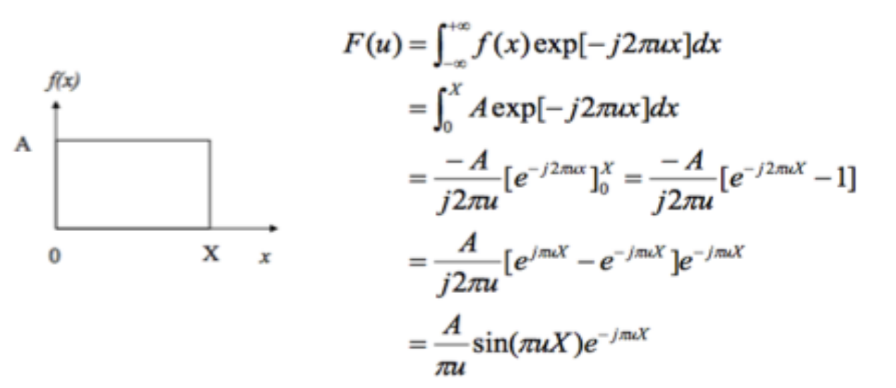
Introduction to the Fourier Transform and the Frequency Domain

Slide 14
Introduction to the Fourier Transform and the Frequency Domain

Slide 15
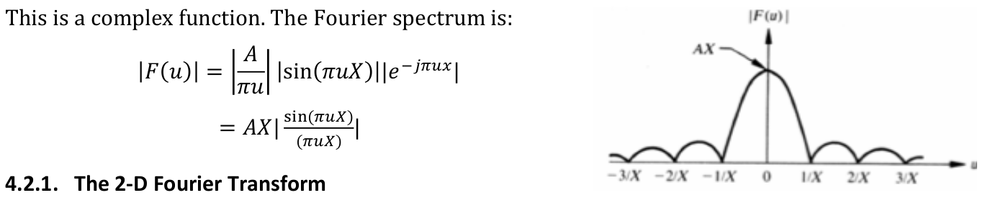
Introduction to the Fourier Transform and the Frequency Domain

Slide 16
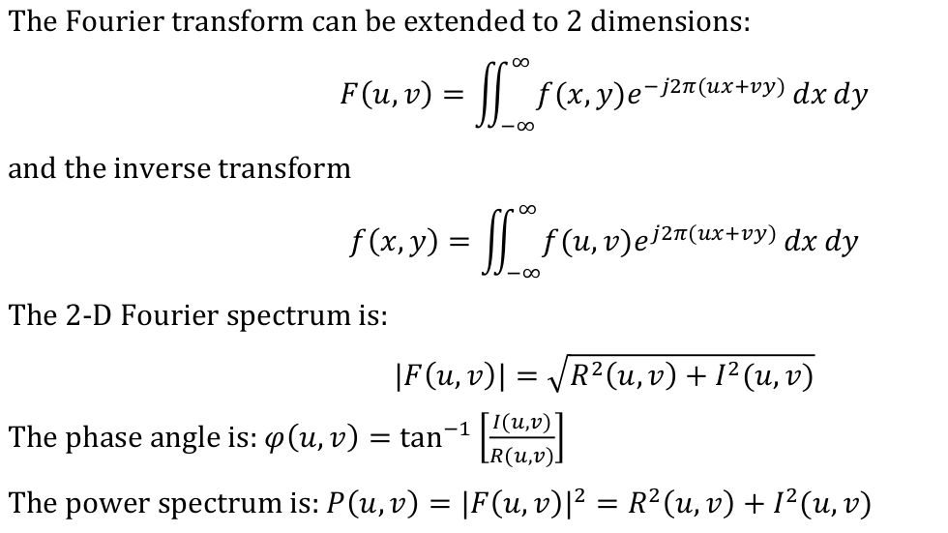
2D Fourier Transform

Slide 17
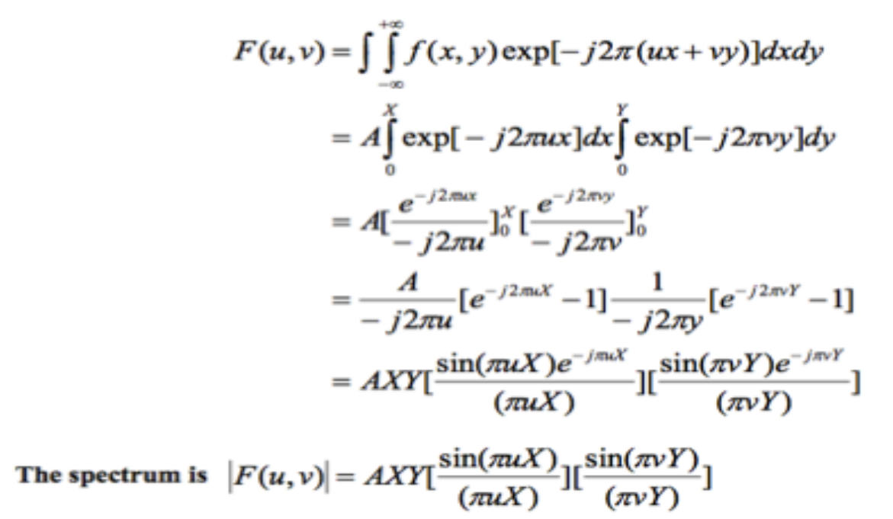
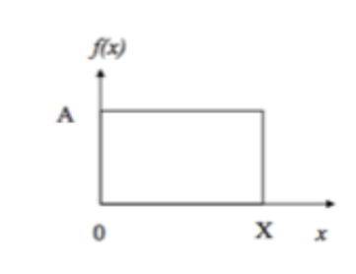
2D Fourier Transform

Slide 18
Discrete Fourier Transform
Discrete Fourier Transform (DFT) is purely discrete
Discrete-time data sets are converted into a discrete-frequency representation.

Slide 19
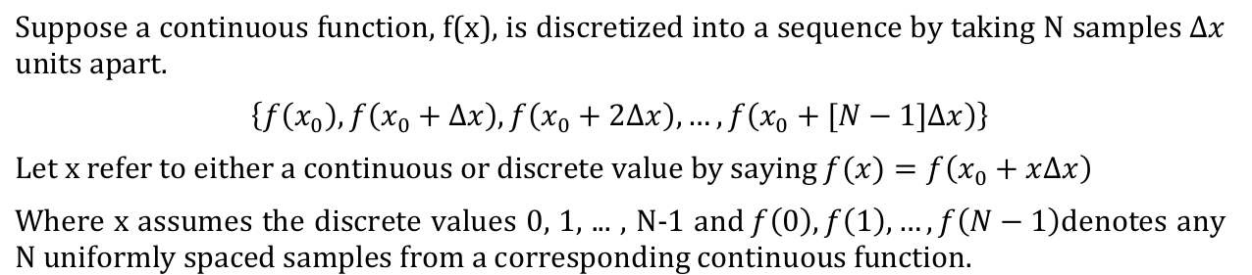
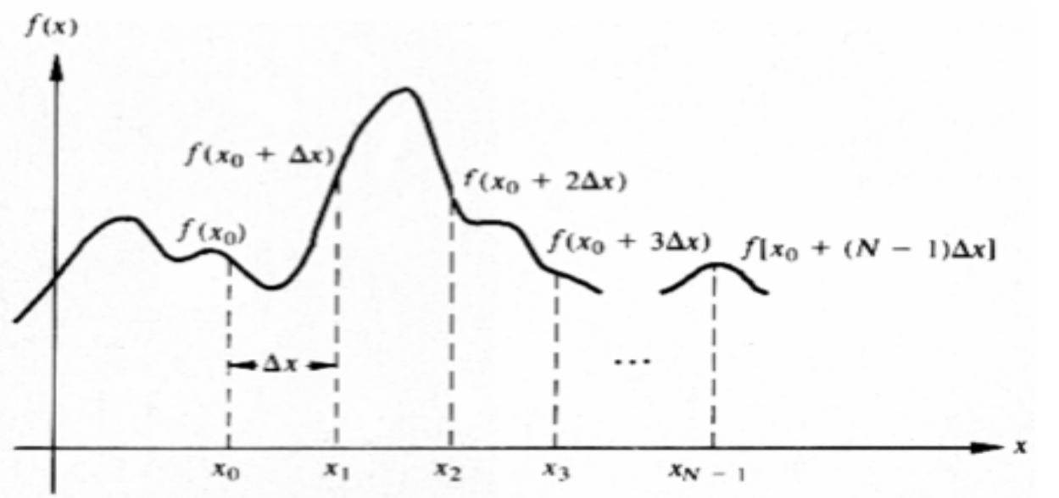
Discrete Fourier Transform

Slide 20
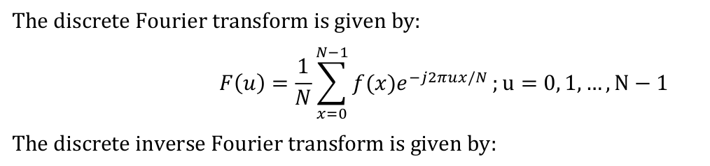
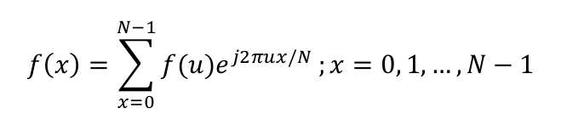
Discrete Fourier Transform

Slide 21
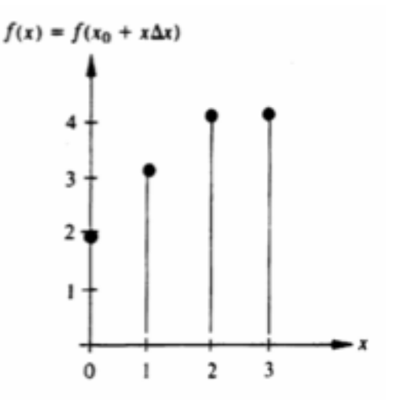
Question
Find the Fourier Spectrum, Phase angle and Power Spectrum for N = 0 and 1

Slide 22
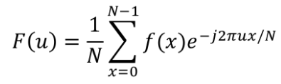
Solution
Given,
f(0) =2
f(1) =3
f(2) =4
f(3) =4
Where N= 4 (0,1,2,3)

Slide 23



Solution
For U = 0
Fourier Spectrum
=
=
Power Spectrum
=
=
Phase Angle
=
=
= 0.2984

Slide 24
Solution
For U = 1
=

Slide 25
Solution
For U = 1
Fourier Spectrum
=
=
Power Spectrum
=
=
Phase Angle
=
= -0.4636

Slide 26
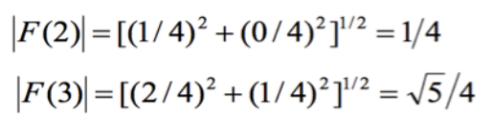
Practice
Calculate for U=2 and 3

Slide 27
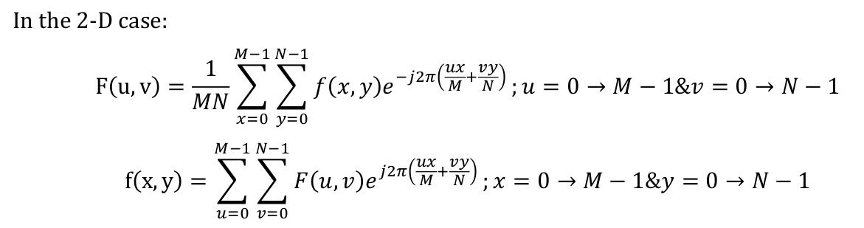
2-D Discrete Fourier Transform

Slide 28
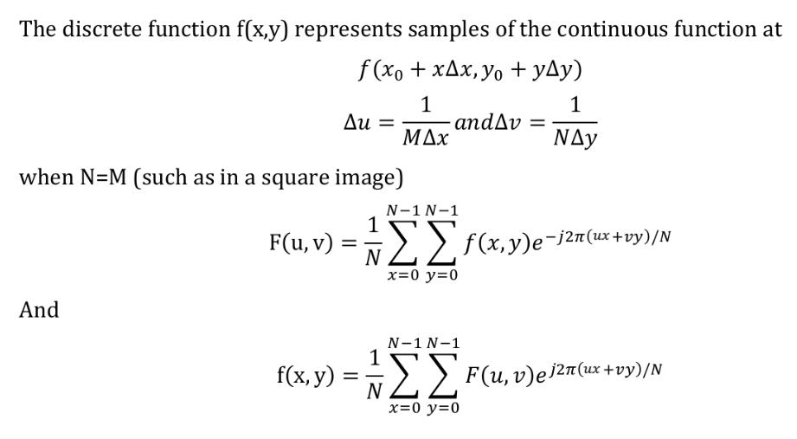
2-D Discrete Fourier Transform

Slide 29
2-D Discrete Fourier Transform
  Magnitude or spectrum
Phase angle or phase spectrum
Power spectrum or spectral density

Slide 30
Filtering in the frequency domain
Filter Parameters
Distance Function
To generate filter transfer functions, it is necessary to know the distance of each element of the transfer function to the origin (0,0). In the filter transfer function equations, this distance to the origin is denoted as (D(u,v)) , or simply as D .
Since the frequency domain data ranges from 0 to 2π in both the horizontal and vertical direction, rather than between –π and π, it is convenient to use a special function to calculate the distances.
Cutoff Frequency
The transition point between the pass and stop bands of the filter is denoted as D₀
Band Width
For band-reject and band-pass filters, where the data between lower and upper cutoff frequencies is either rejected or passed, the width is denoted as W .

Slide 31

Properties Of 2D Fourier Transform
The dynamic range of the Fourier spectra is generally higher than can be displayed. A common technique is to display the function
where c is a scaling factor and the logarithm function performs “compression” of the data. ‘c’ is usually chosen to scale the data into the range of the display devices [0,255]

Slide 32
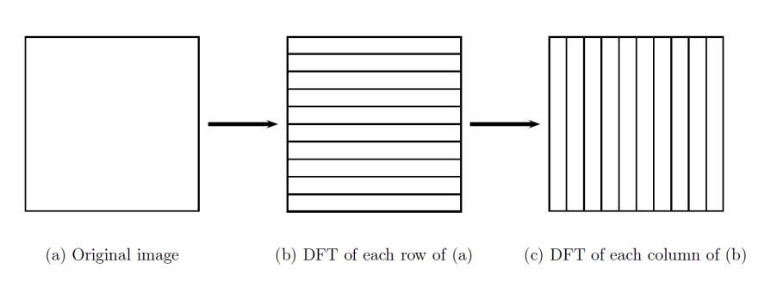
Properties Of 2D Fourier Transform
Separability

Slide 33
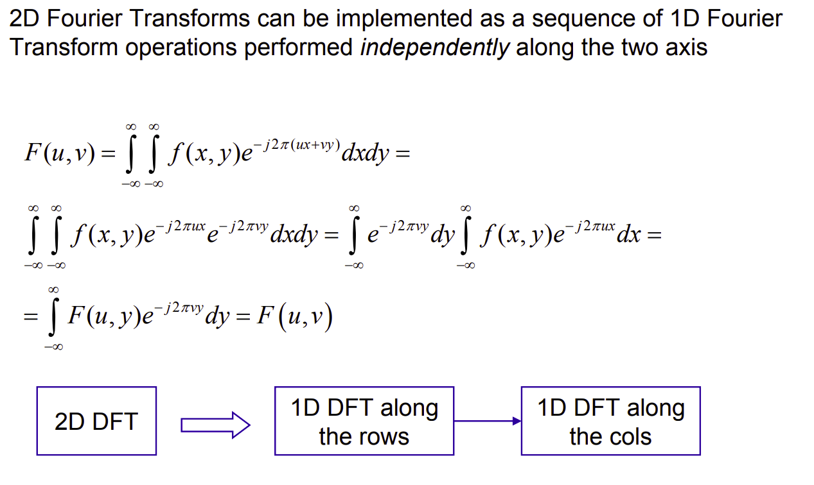
Properties Of 2D Fourier Transform
Separability

Slide 34
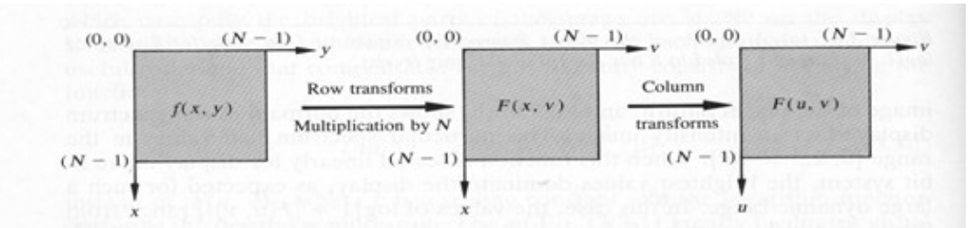
Properties Of 2D Fourier Transform
Separability
The main advantage of separability property is that a Fourier Transform of any dimension can be performed by applying 1D transform on each dimension

Slide 35
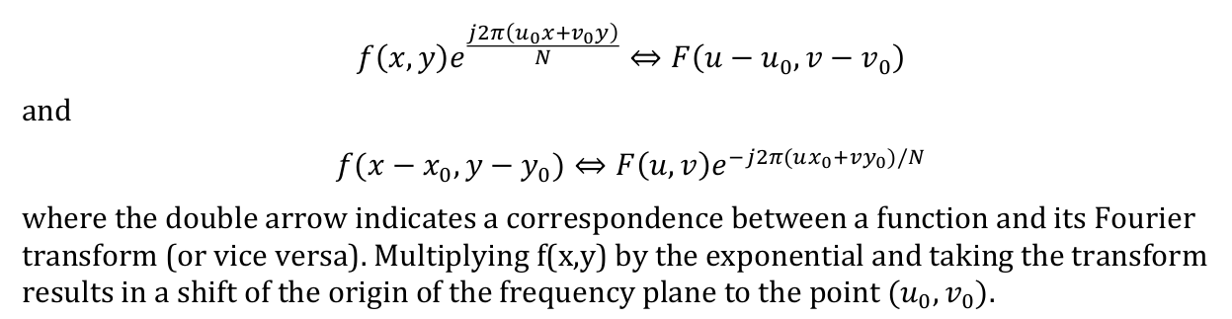
Properties Of 2D Fourier Transform
Translation

Slide 36
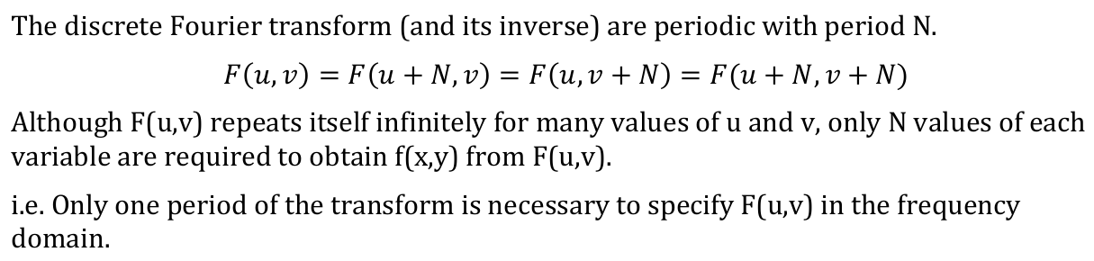
Properties Of 2D Fourier Transform
Periodicity

Slide 37
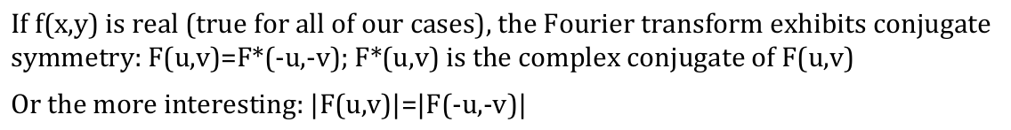
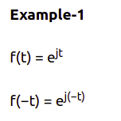

Properties Of 2D Fourier Transform
Conjugate Symmetry

Slide 38
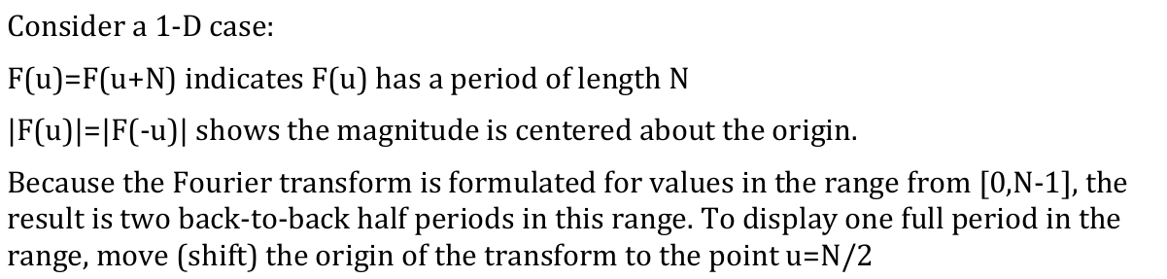
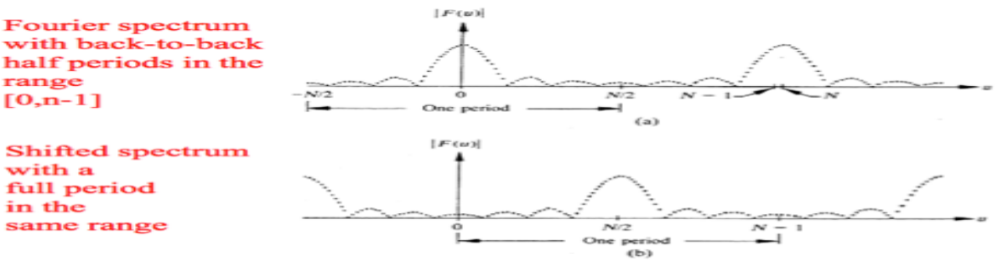
Properties Of 2D Fourier Transform
Implication of Periodicity and Symmetry

Slide 39
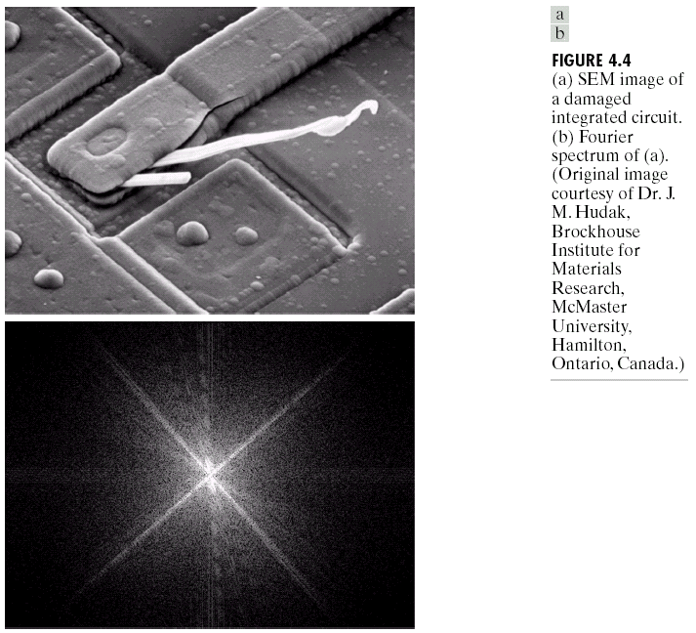
Filtering in the frequency domain
scanning electron microscope

Slide 40
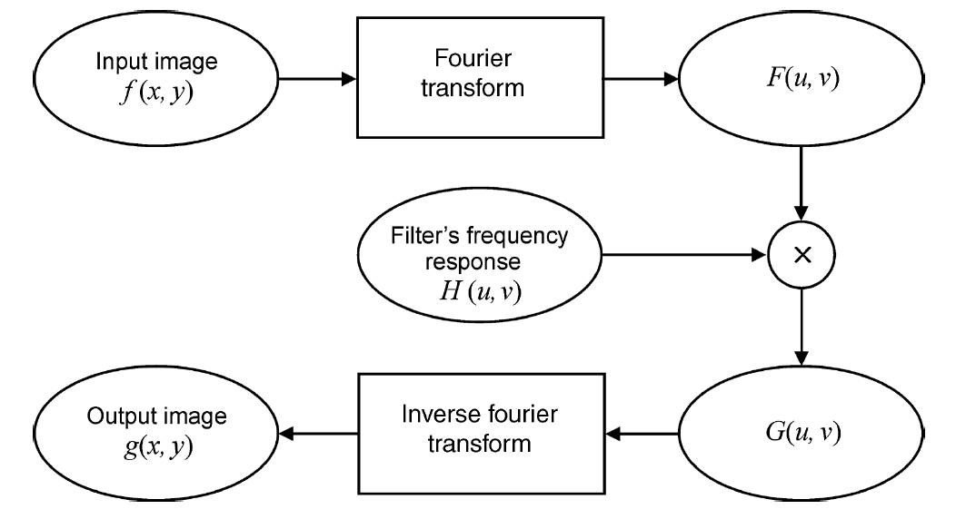
Filtering in the frequency domain

Slide 41
Filtering in the frequency domain
For each filtering operation, we will describe the construction three types of filters in the frequency domain.
- Ideal Filters
- Gaussian Filter
- Butterworth Filter

Slide 42
Filtering in the frequency domain
Ideal Filters
Ideal filters are quick and easy to implement and give an easy to understand appreciation of the filter.
Unfortunately, ideal filters typically yield undesired results.
Specifically, ideal filters suffer from a problem known as ringing where extra lines appear around the edges of objects in an image

Slide 43
Filtering in the frequency domain
Gaussian Filters
The shape of a Gaussian filter transfer function is bell-shaped curve that models the probability distribution function
The smooth transition between the pass-band and stop-band produces good results with no noticeable ringing artifacts. The cutoff frequency of Gaussian filters is determined by a variable (σ).

Slide 44
Filtering in the frequency domain
Butter worth Filters
The shape of a butter worth filter transfer function is tune-able
The order of the filter (n) determines the gradient of the transition between the pass-band and stop-band.
It can assume a gentle transition like in Gaussian filters, or it can assume an abrupt transition like ideal filters.
A nice aspect of Butter worth filters is that the cutoff frequency is a parameter of transfer function equation. Thus, it is simpler to determine the parameters from examining the image in the frequency domain.

Slide 45
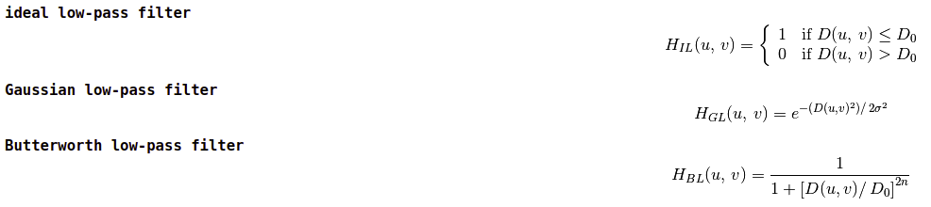
Filtering in the frequency domain
Smoothing Filters

Slide 46
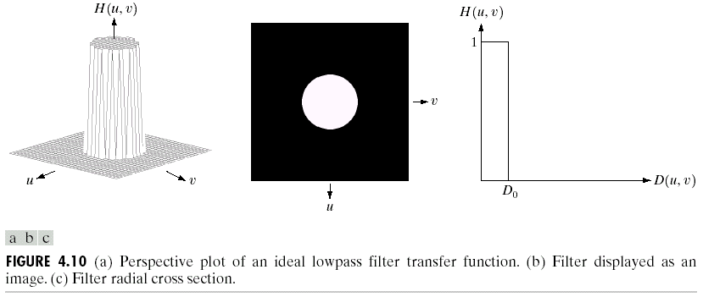
Smoothing Frequency-Domain Filter
Ideal Low Pass

Slide 47
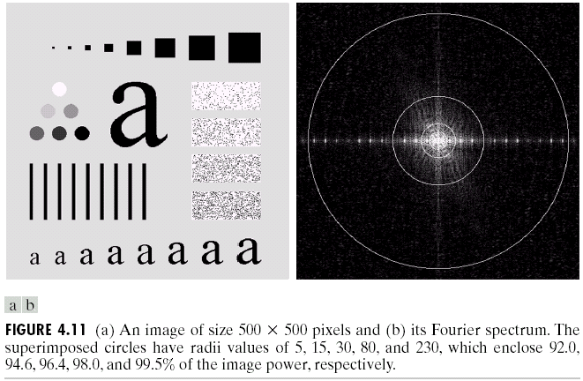
Smoothing Frequency-Domain Filter
Ideal Low Pass

Slide 48
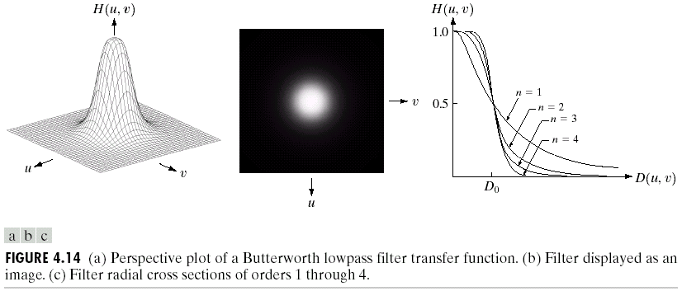
Smoothing Frequency-Domain Filter
Butterworth Low Pass

Slide 49
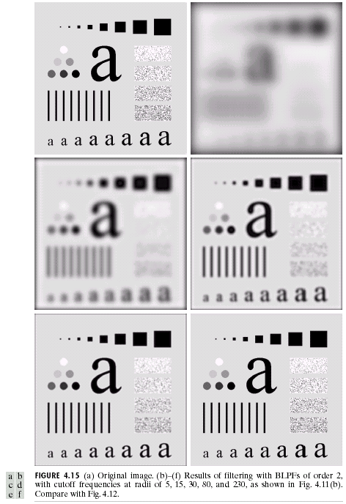
Smoothing Frequency-Domain Filter
Butterworth Low Pass

Slide 50
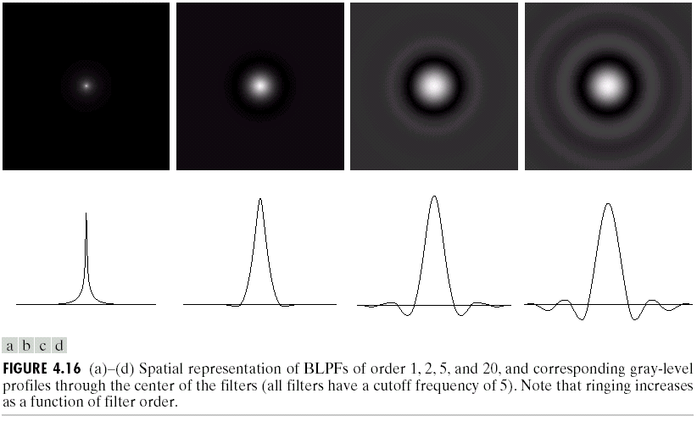
Smoothing Frequency-Domain Filter
Butterworth Low Pass

Slide 51
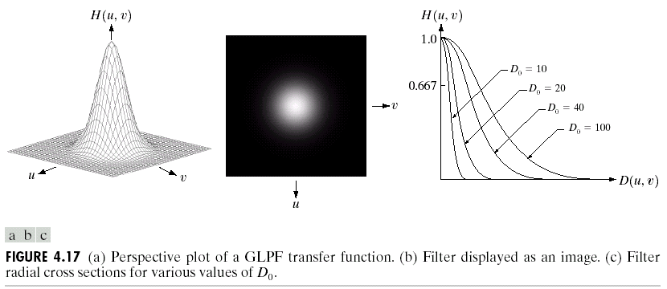
Smoothing Frequency-Domain Filter
Gaussain Low Pass

Slide 52
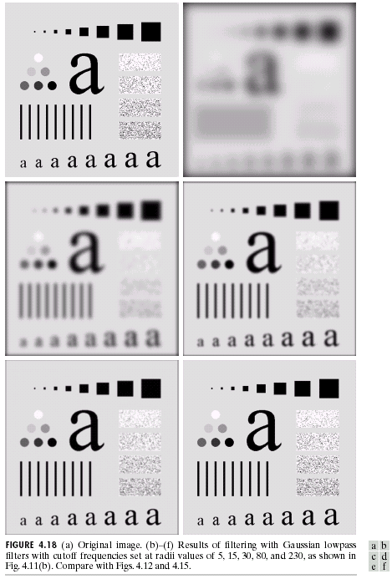
Smoothing Frequency-Domain Filter
Gaussain Low Pass

Slide 53
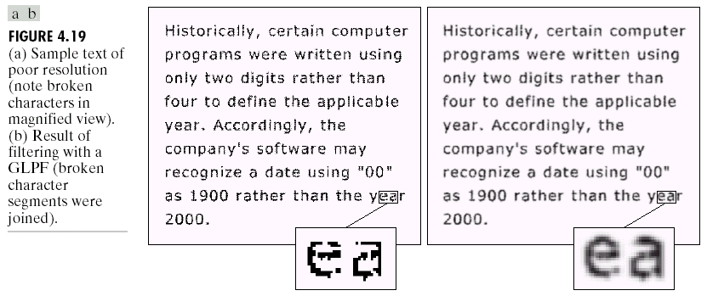
Smoothing Frequency-Domain Filter
Gaussain Low Pass

Slide 54
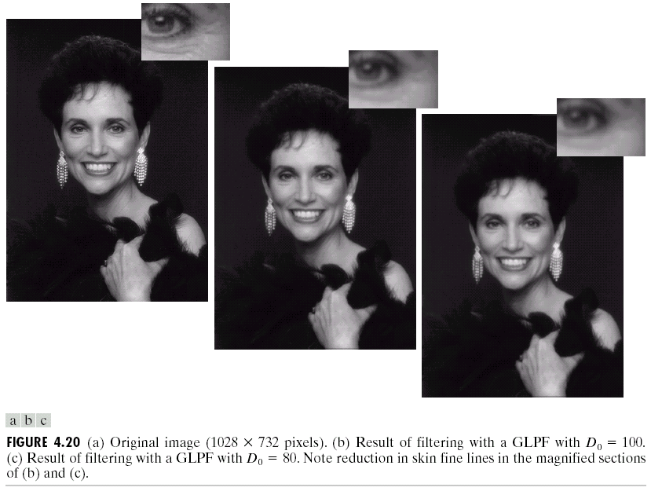
Smoothing Frequency-Domain Filter
Gaussain Low Pass

Slide 55
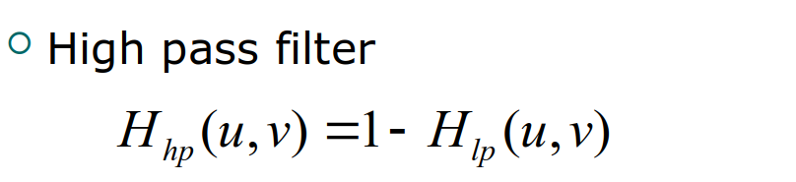
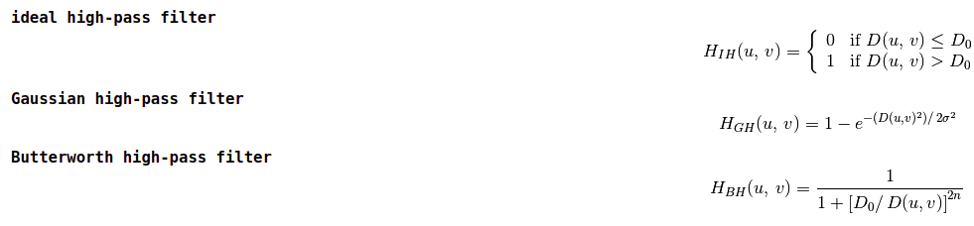
Filtering in the frequency domain
Sharpening Filters

Slide 56
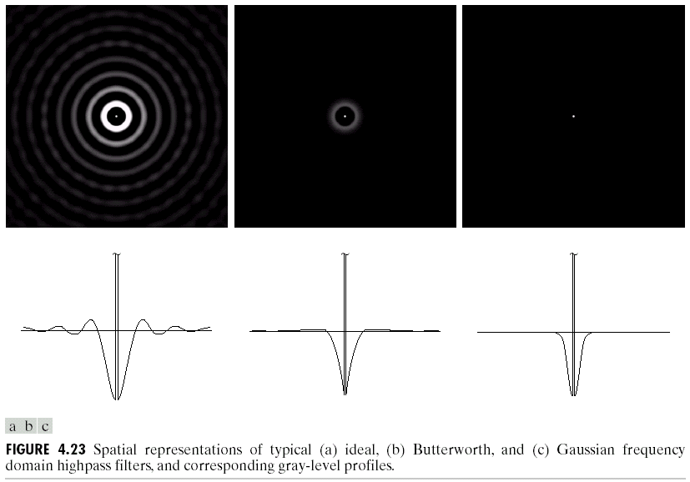
Sharpening Frequency-Domain Filter
High Pass

Slide 57
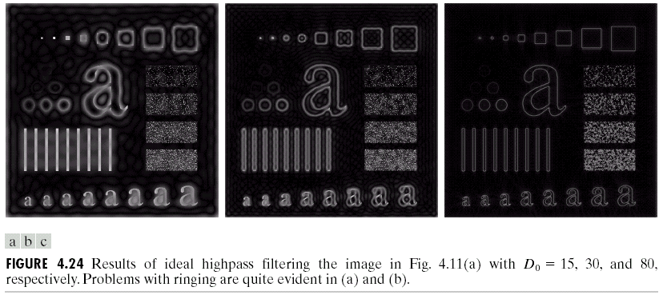
Sharpening Frequency-Domain Filter
Ideal High Pass

Slide 58
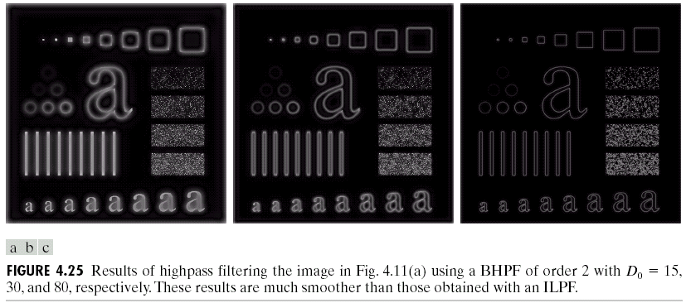
Sharpening Frequency-Domain Filter
Butterworth High Pass

Slide 59
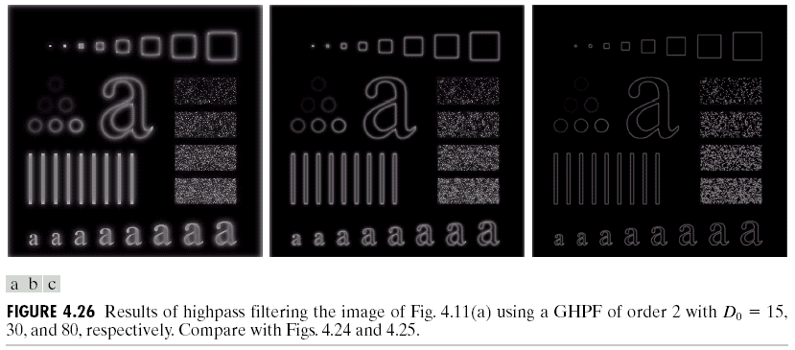
Sharpening Frequency-Domain Filter
Gaussian High Pass

Slide 60
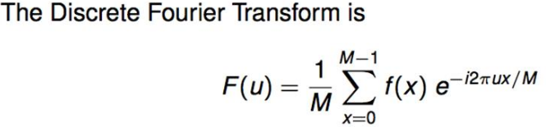
Fast Fourier Transform
Time Complexity :
O(M²)
Cannot it be made Faster?

Slide 61
Fast Fourier Transform
In image processing, the most common way to represent pixel location is in the spatial domain by column (x), row (y), and z(value). But sometimes image processing routines may be slow or inefficient in the spatial domain, requiring a transformation to a different domain that offers compression benefits.
A common transformation is from the spatial to the frequency (or Fourier) domain. The frequency domain is the basis for many image filters used to remove noise, sharpen an image, analyze repeating patterns, or extract features. In the frequency domain, pixel location is represented by its x- and y-frequencies and its value is represented by amplitude.
The Fast Fourier Transform (FFT) is commonly used to transform an image between the spatial and frequency domain.
- FFT method preserves all original data.
- FFT fully transforms images into the frequency domain
- FFT decomposes an image into sines and cosines of varying amplitudes and phases, which reveals repeating patterns within the image.

Slide 62
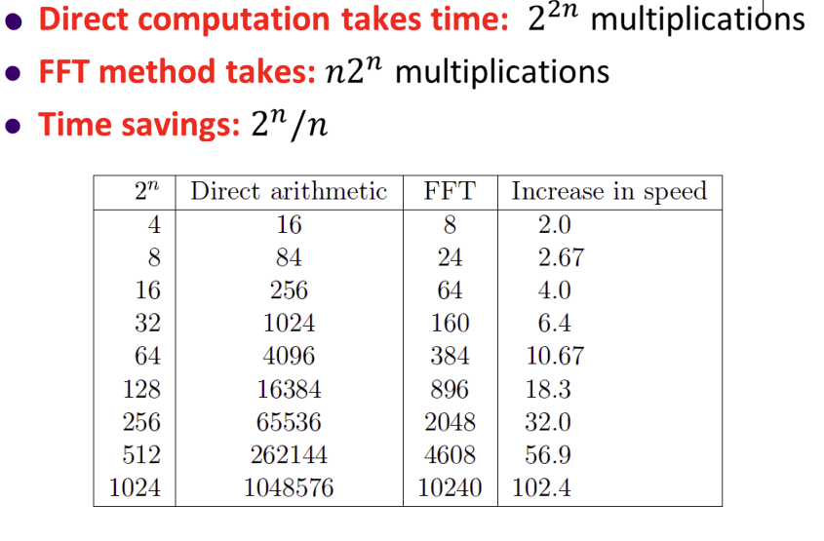
Fast Fourier Transform

Slide 63
Fast Fourier Transform
Time Complexity
The Fast Fourier Transform (FFT) is a way to reduce the complexity of the Fourier transform computation from O(n²) to O(nlogn) which is a dramatic improvement.

Slide 64
Fast Fourier Transform
Radix-2 (DIT/DIF)
Radix-2 is the first FFT algorithm
It was proposed by Cooley and Tukey in 1965
Though it is not the most common algorithm, it laid the foundation for efficient DFT Calculation.
The algorithm appear in
- Decimation In Time (DIT) , or
- Decimation in Frequency (DIF)

Slide 65
Fast Fourier Transform
The radix-2 DIT case
A radix-2 decimation-in-time (DIT) FFT is the simplest and most common form of the Cooley-Tukey algorithm, although highly optimized Cooley-Tukey implementations typically use other forms of the algorithm as described below. Radix-2 DIT divides a DFT of size N into two interleaved DFTs (hence the name "radix-2") of size N/2 with each recursive stage.

Slide 66
Fast Fourier Transform
The radix-2 DIT case
Assignment (FFT → DIT)
x(n) = {1,1,1,0,0,0,0,0}

Slide 67
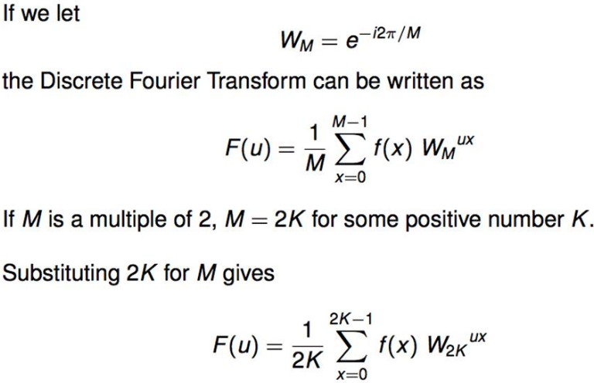
Fast Fourier Transform
The radix-2 DIT case

Slide 68

Fast Fourier Transform
The radix-2 DIT case

Slide 69

Fast Fourier Transform
The radix-2 DIT case

Slide 70

Convolution
Mathematical operation on two functions (f and g) that produces a third function (f*g) that expresses how the shape of one is modified by the other.

Slide 71

Zero Padding
Zero padding is a technique typically employed to make the size of the input sequence equal to a power of two.
In zero padding, you add zeros to the end of the input sequence so that the total number of samples is equal to the next higher power of two.
For example, if you have 10 samples of a signal, you can add six zeros to make the total number of samples equal to 16, or 32, which is a power of two

Slide 72

Correlation
The correlation theorem says that multiplying the Fourier transform of one function by the complex conjugate of the Fourier transform of the other gives the Fourier transform of their correlation.
That is, take both signals into the frequency domain, form the complex conjugate of one of the signals, multiply, then take the inverse Fourier transform. This is expressed by:

Slide 73
Hadamard Transform
The Hadamard transform H_{m} is a 2^{m} x 2^{m} matrix, the Hadamard matrix, that transforms 2^{m} real numbers x_{n} into 2^{m} real numbers X_{k}
The Hadamard transform can be defined in two ways:
- recursively,
- binary(base-2) representation of the indices n and k

Slide 74



Hadamard Transform
We define the 1 × 1 Hadamard transform H₀ by the identity H₀ = 1, and then define H_{m} for m > 0 by:

Slide 75


Haar Wavelets
The haar wavelet is a sequence of rescaled "square-shaped" functions which together form a wavelet family or basis.
Wavelet analysis is similar to Fourier analysis in that it allows a target function over an interval to be represented in terms of an orthonormal (Mutual perpendicular along a line) basis.
The Haar wavelet's mother wavelet function ᵩ(t) can be described as

Slide 76
Haar Transform
The Haar transform is the simplest of the wavelet transforms.
This transform cross-multiplies a function against the Haar wavelet with various shifts and stretches
It is found effective in applications such as signal and image compression in electrical and computer engineering as it provides a simple and computationally efficient approach for analysing the local aspects of a signal.

Slide 77

Haar Transform

Slide 78

Haar Transform

Slide 79

Haar Transform
The Haar transform matrix of order L consists of rows resulting from the preceding functions computed at the points z = m/L, m = 0, 1, 2,…, L − 1. For example, the 8 × 8 transform matrix is

Slide 80

Haar Transform

Slide 81

Discrete Cosine Transform (DCT)

Slide 82

Discrete Cosine Transform (DCT)

